Slide 1

Library management system
Group 8
Yunchen Yuan 21100038d
Yuzhou Liu 21100602d
Tong Li 21101988d
Kaijing Yu 21098256d
Zhoudao Lu 21099695d

Slide 2
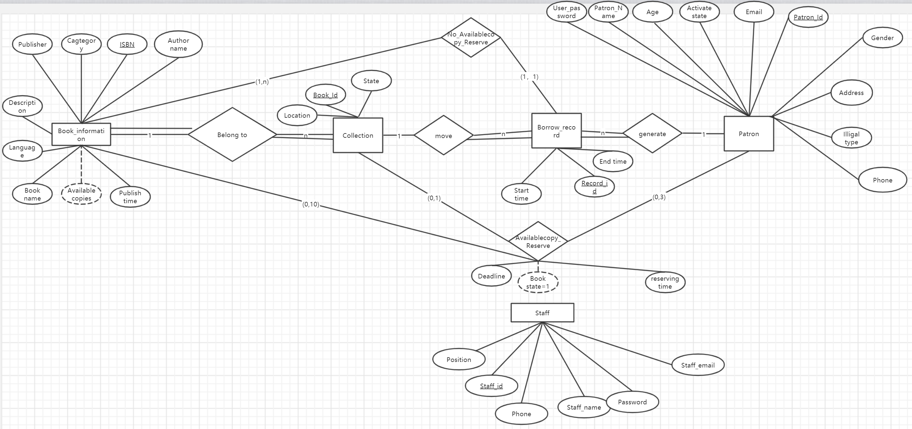
ER diagram

Slide 3
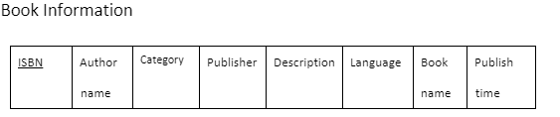
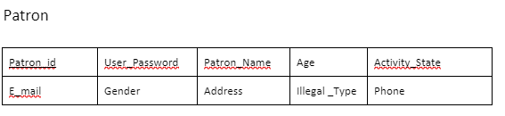
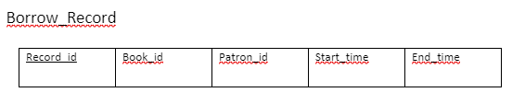
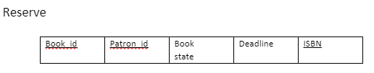
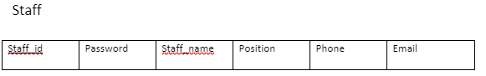
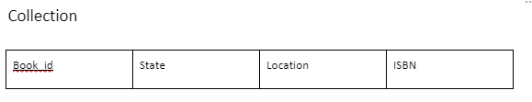
Rational schema & BCNF Analysis

Slide 4
Design
Welcome page
Staff page
Patron page

Slide 5
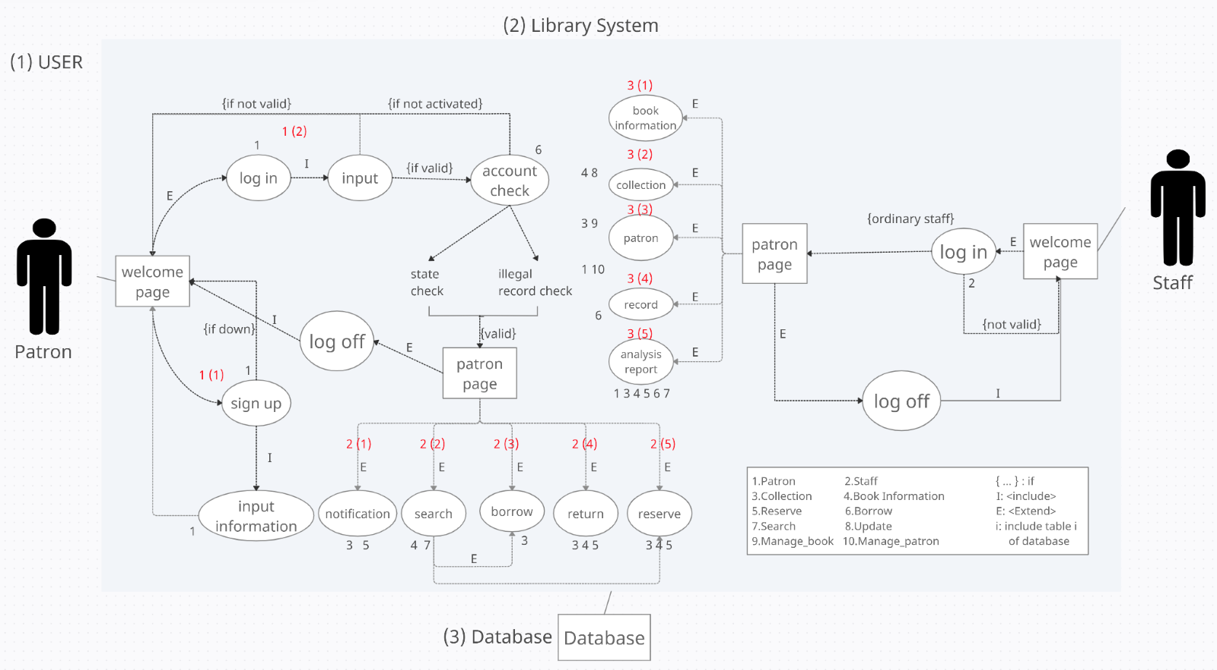
Over View design

Slide 6
Welcome page
Login as patron
Sign up as patron
Login as staff

Slide 7
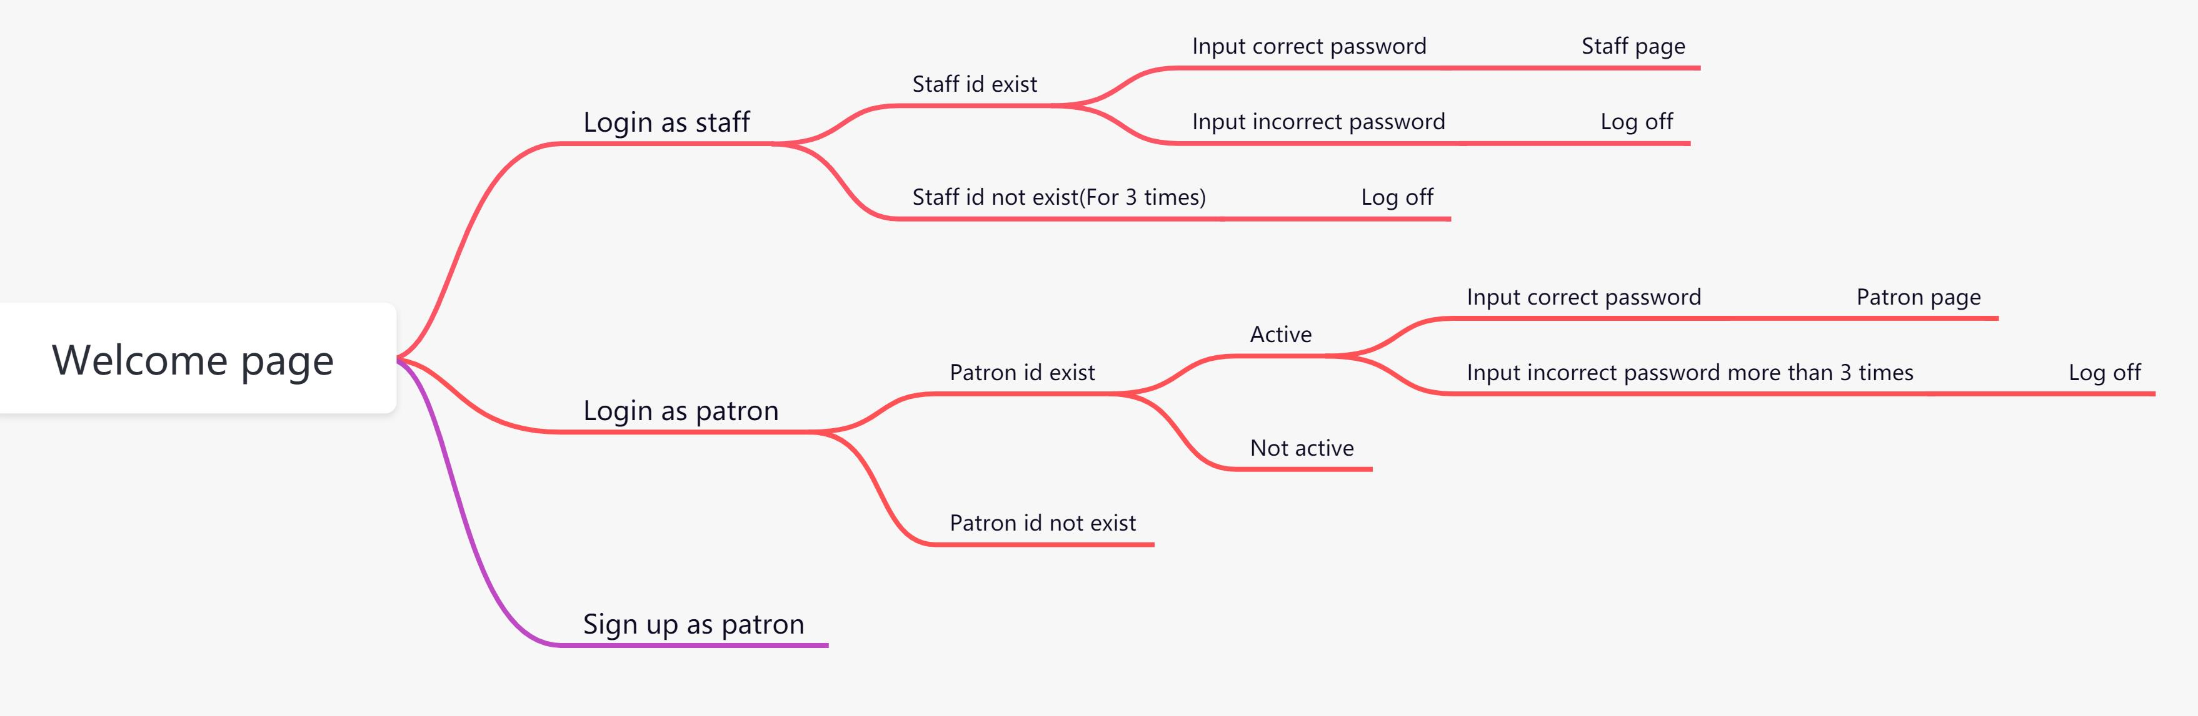
Flow chart

Slide 8
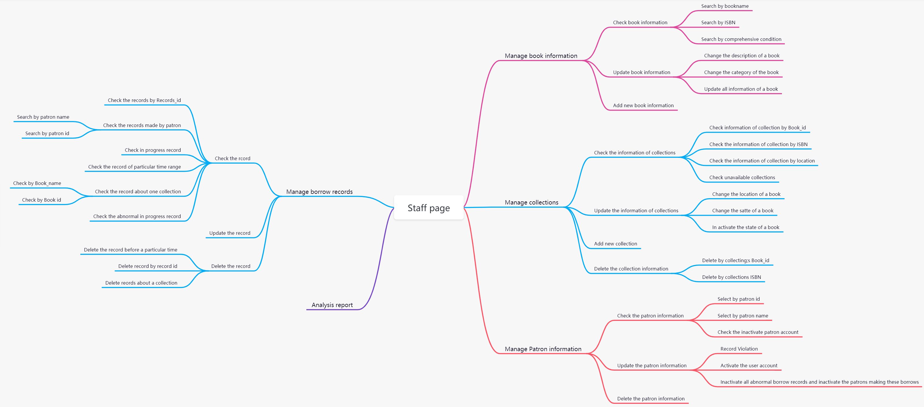
Staff page

Slide 9
Patron page
Search
Borrow
Return
Reserve
Notification

Slide 10
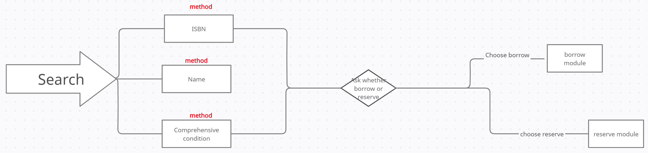
SEARCH

Slide 11
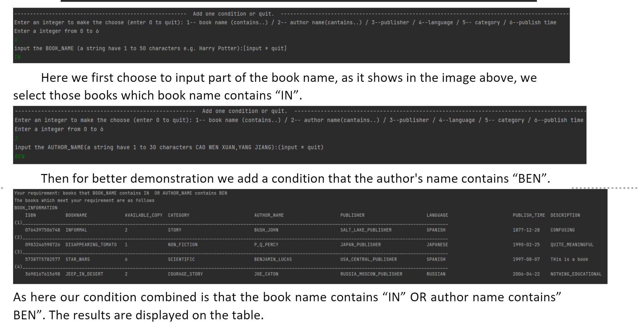
Comprehensive search

Slide 12
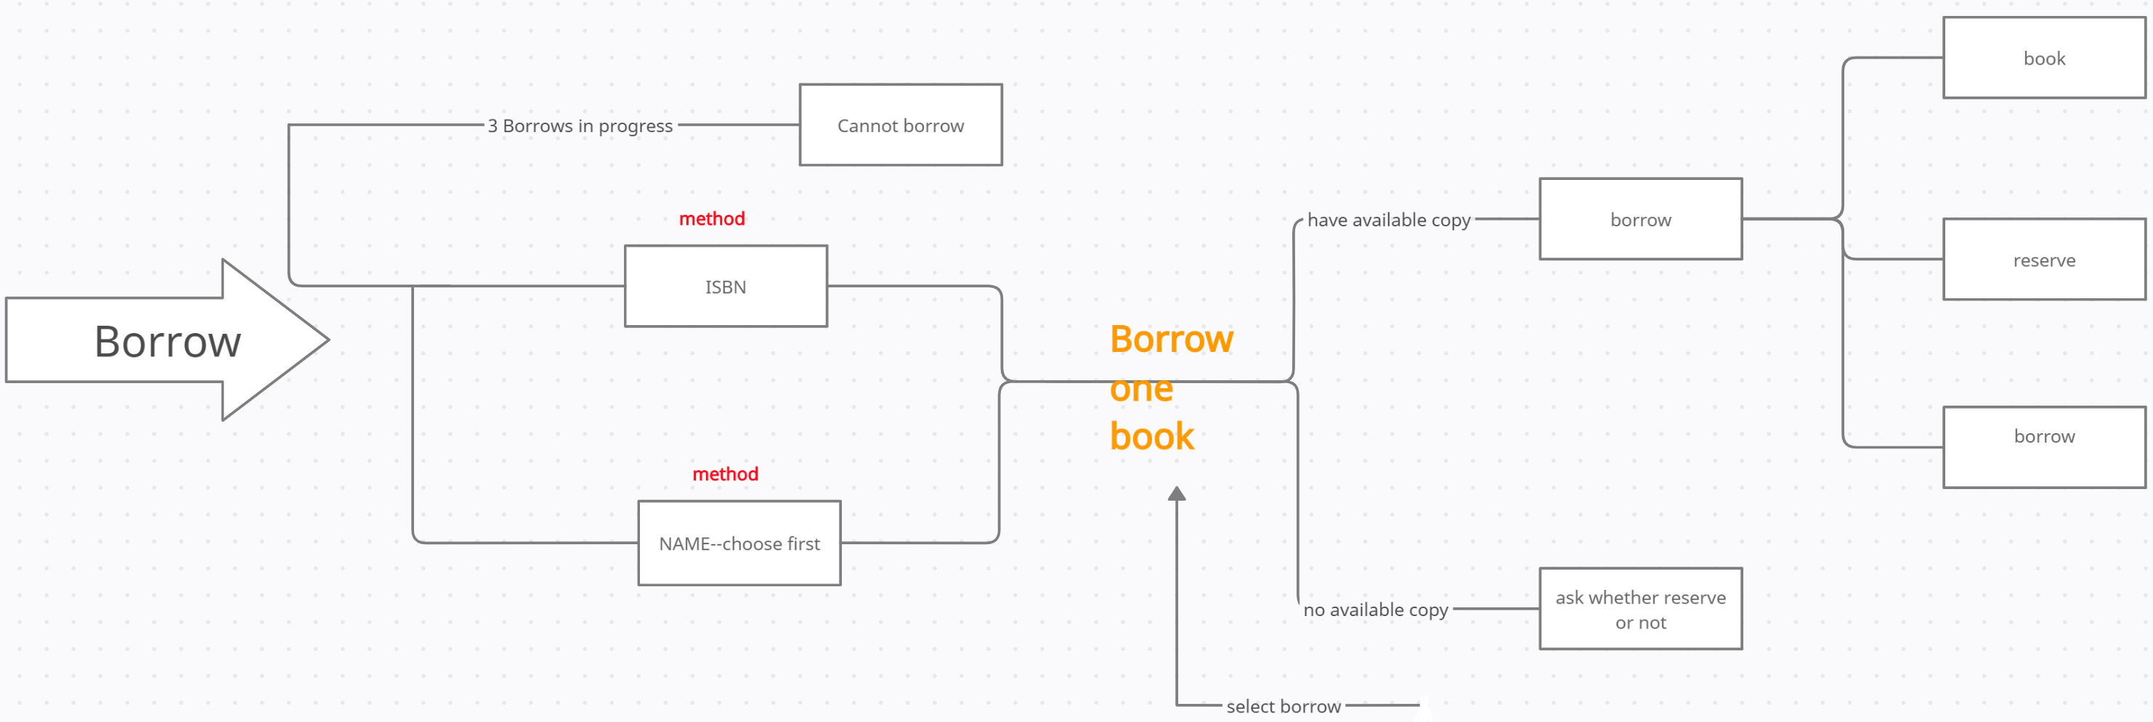
Borrow

Slide 13
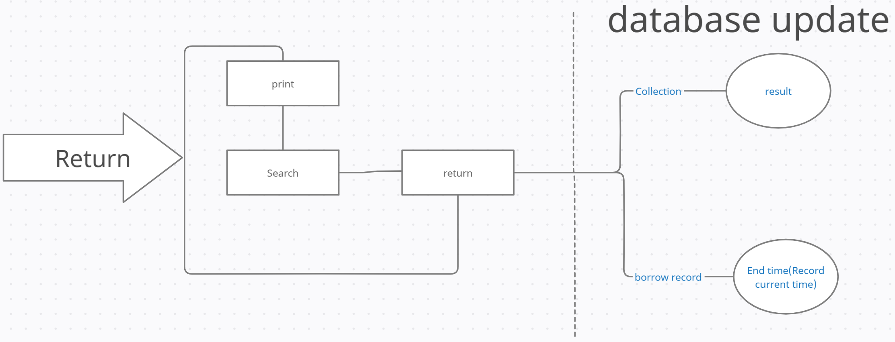
RETURN

Slide 14
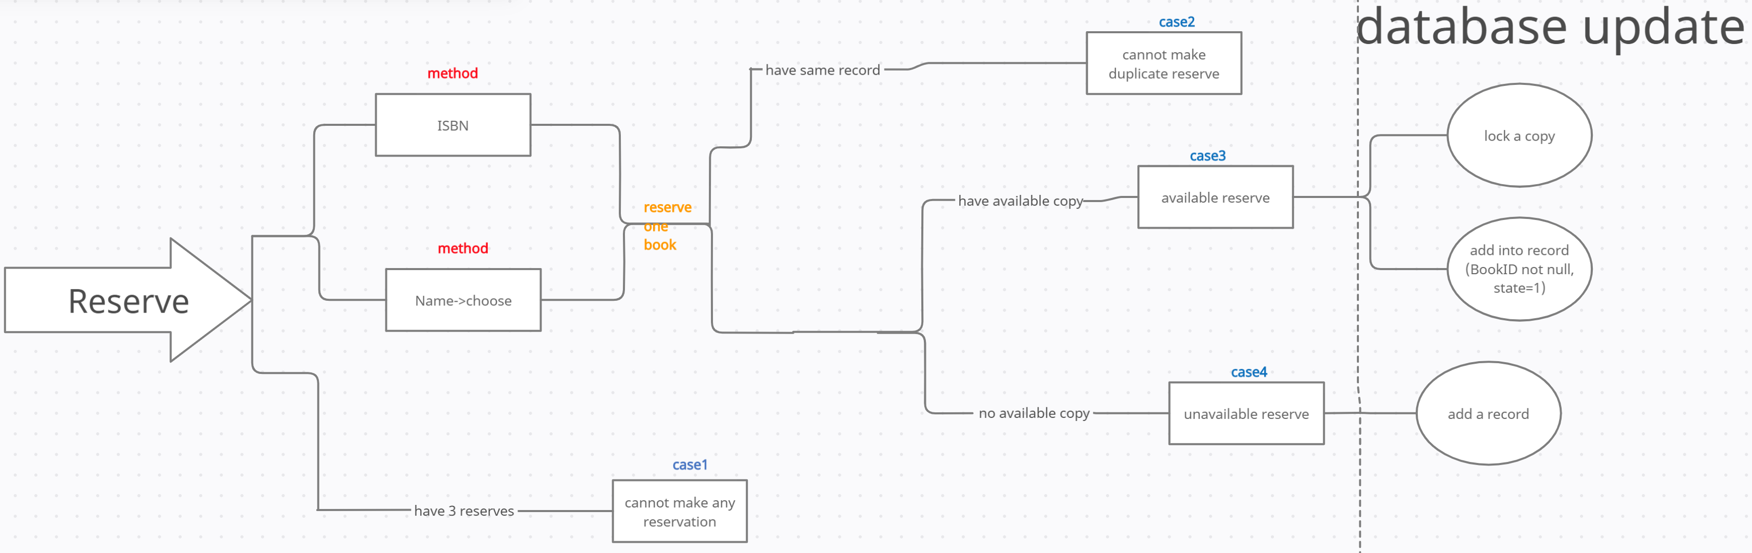
RESERVE

Slide 15
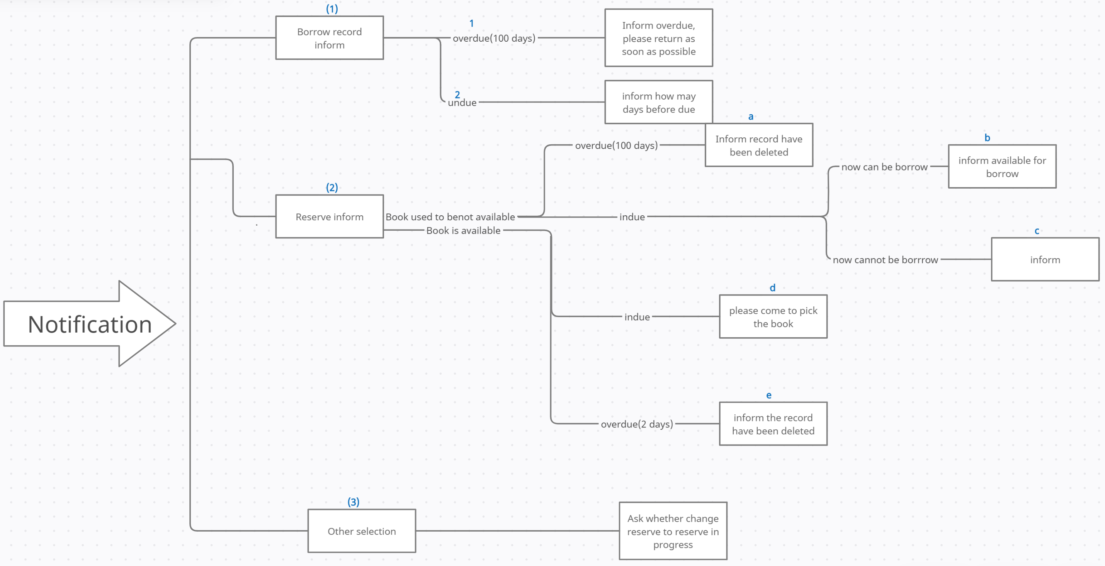
Notification

Slide 16
Analysis report
Book information analysis
Book analysis
Patron analysis
Borrow records analysis
In process reserve analysis

Slide 17
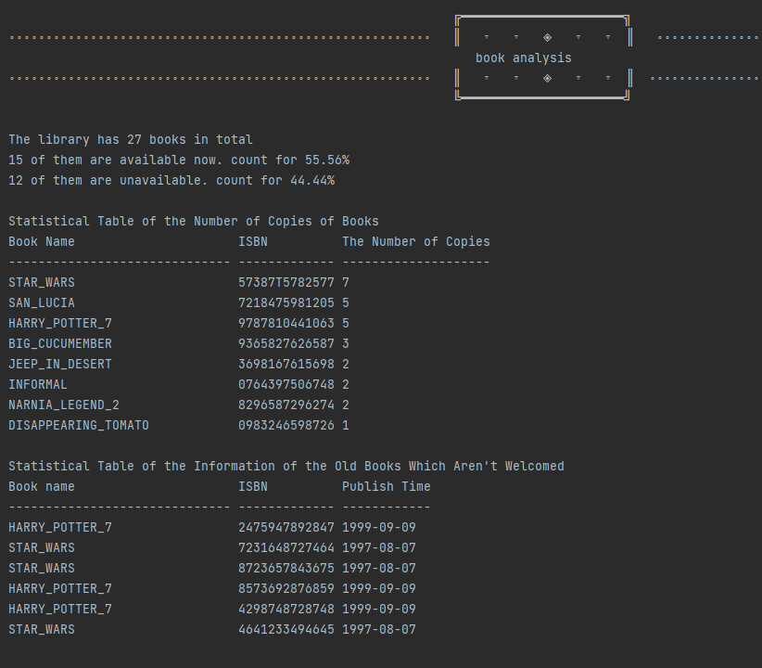
Example
database

Slide 18

System implementation

Slide 19

1, overview:

Slide 20
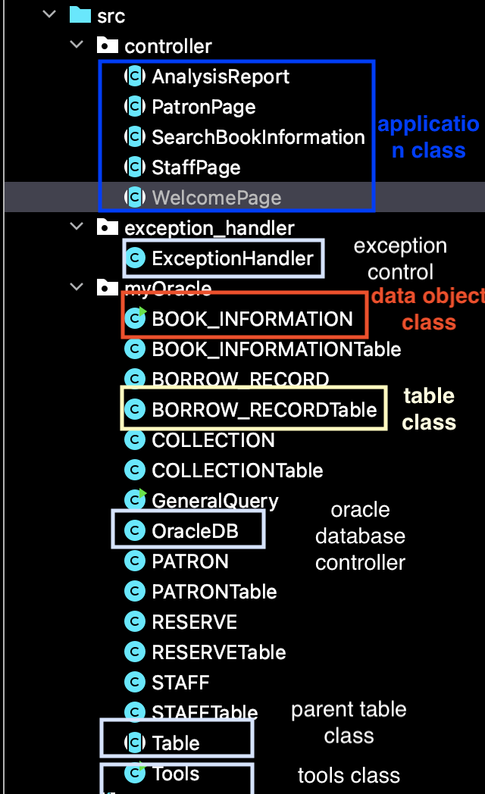
Main Structure
1, data object class: representation of records in java
object-oriented
2, table class
Providing all jdbc operations. Encapsules the details about jdbc and sql.
process--oriented
3, application class
implement the logic of system functions.
Three main kinds
Of classes
Notes:
here are several kind of classes in the library management system.
The most important three kinds of class is application class, data object class and table class.
The table class refer to every table in the oracle database, providing the interface to handle queries. All the jsbc details and SQL query is encapsuled in the methods of this kind of classes.
The data object class is the representation of every tables’ tuples in java.
The application class implement the process of functions.

Slide 21
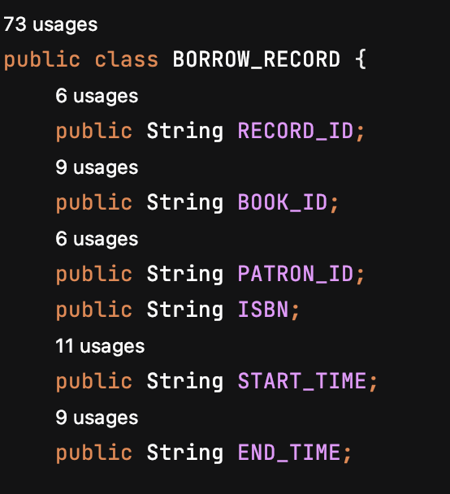
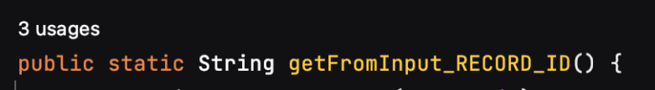
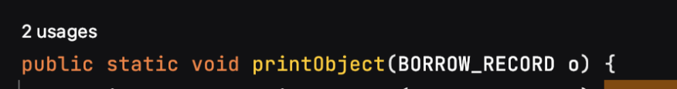
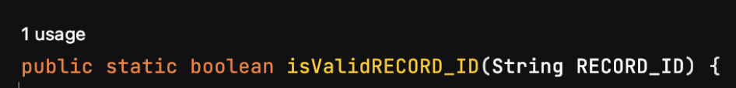
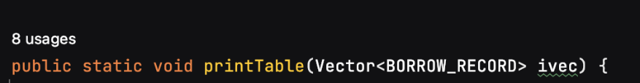
(1) Data object class
CREATE TABLE BORROW_RECORD(RECORD_ID CHAR(10),BOOK_ID CHAR(15), PATRON_ID CHAR(15), ISBN CHAR(10),START_TIME CHAR(10),END_TIME CHAR(10),primary key….);
Representation in database
Representation in java
Provide methods
……

Slide 22
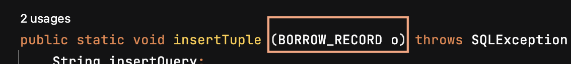
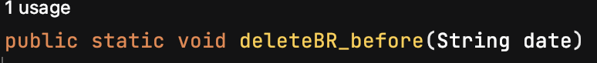
(2) Table class
correspond one-to-one to database tables
databse
select
update
Table class
Jdbc & sql
insert
parameter
data object
delete
application class
java

Slide 23
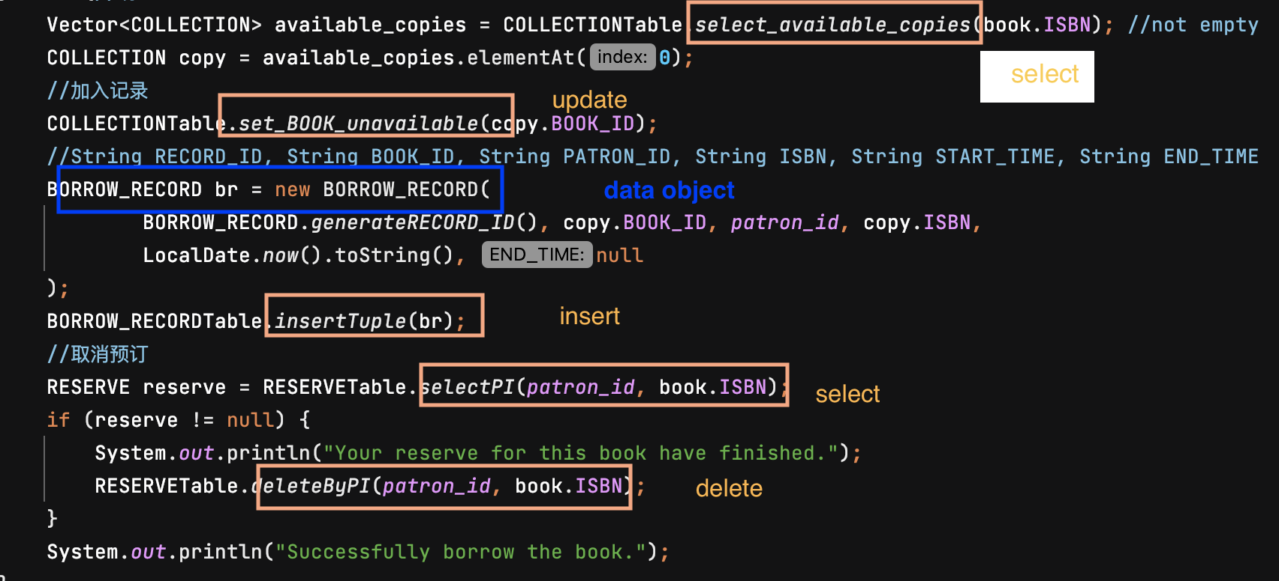
Only java semantic: focus on the implementation of system functions
(3) Application class
Notes:
Because of the encapsules of above two classes, the code in the application classes do not have any jdbc and sql expression, only focusing on the logic of functions.
Here is a screenshot of a piece of borrow function. You can see that the logic is quite clear. Although this function perform several sql operations, this piece of code do not contains any sql expression or jdbc details.

Slide 24

2, jdbc sample functions

Slide 25
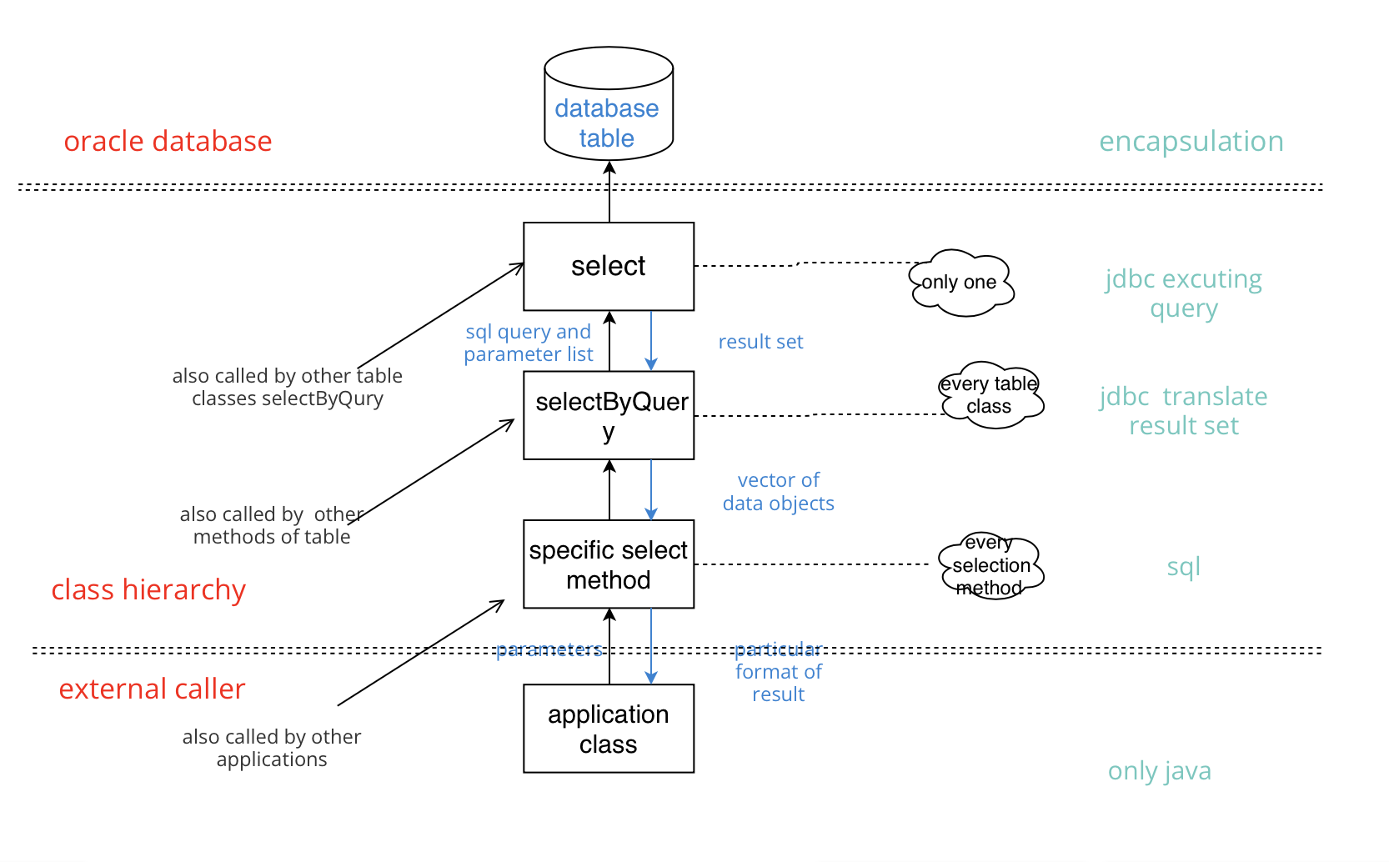

Slide 26
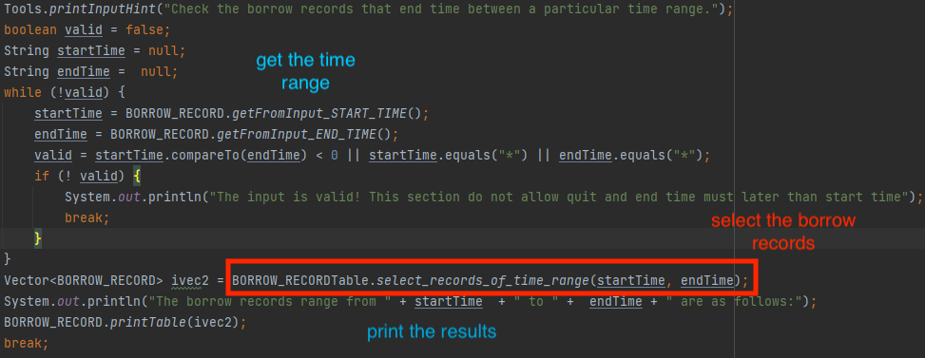
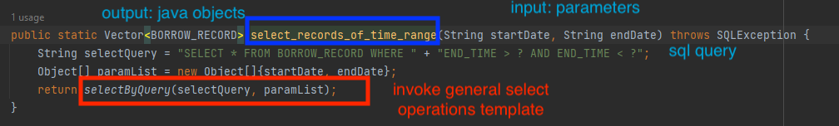
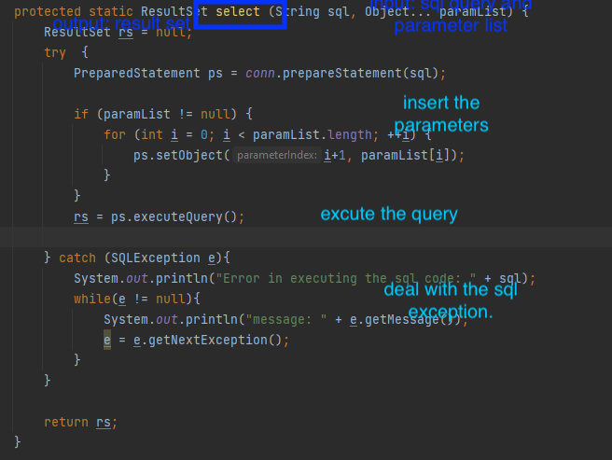
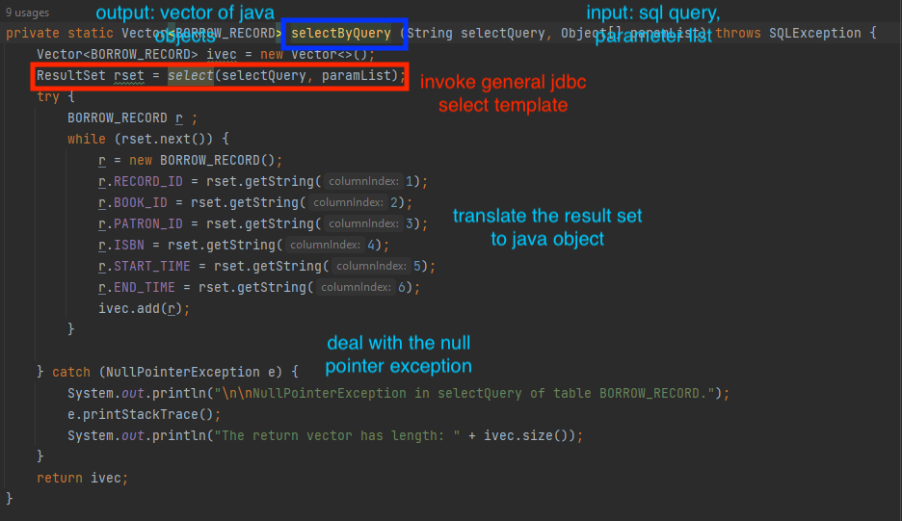
Four levels

Slide 27

3, library system functions implementation

Slide 28
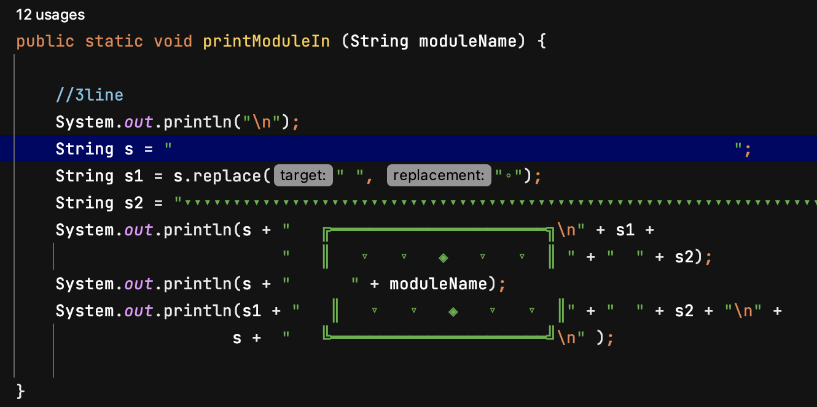
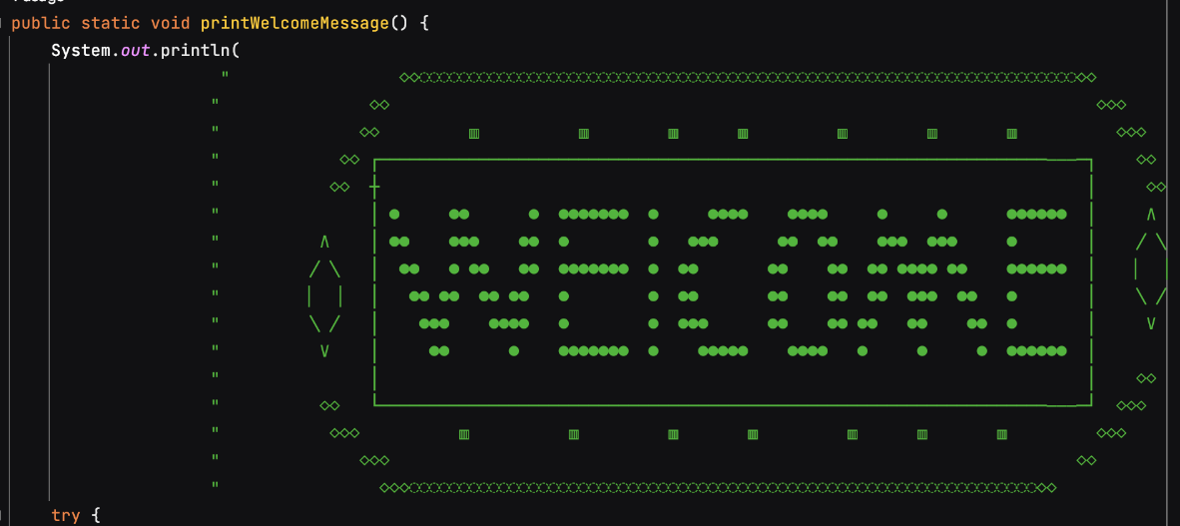
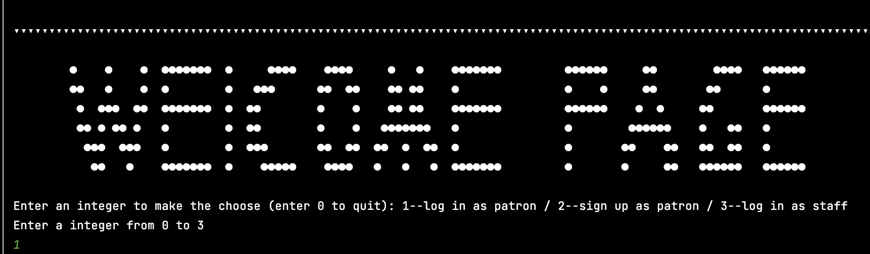

(1) Intuitive interaction

Slide 29
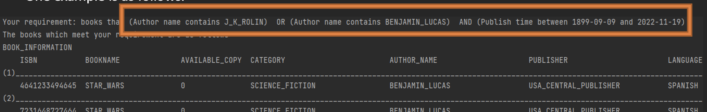
(2) Sample implementation: Comprehensive condition search
Search book information by comprehensive search
String connection(sql)
Not safe, break the encapsulation
Two ways
HashSet (java)
Not efficient, but safe

Slide 30
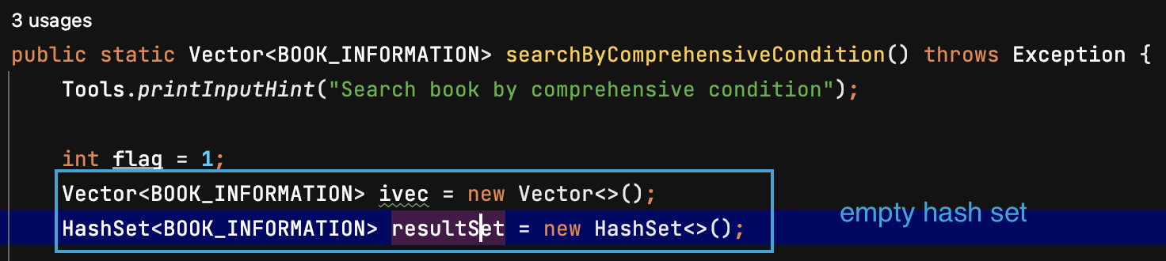
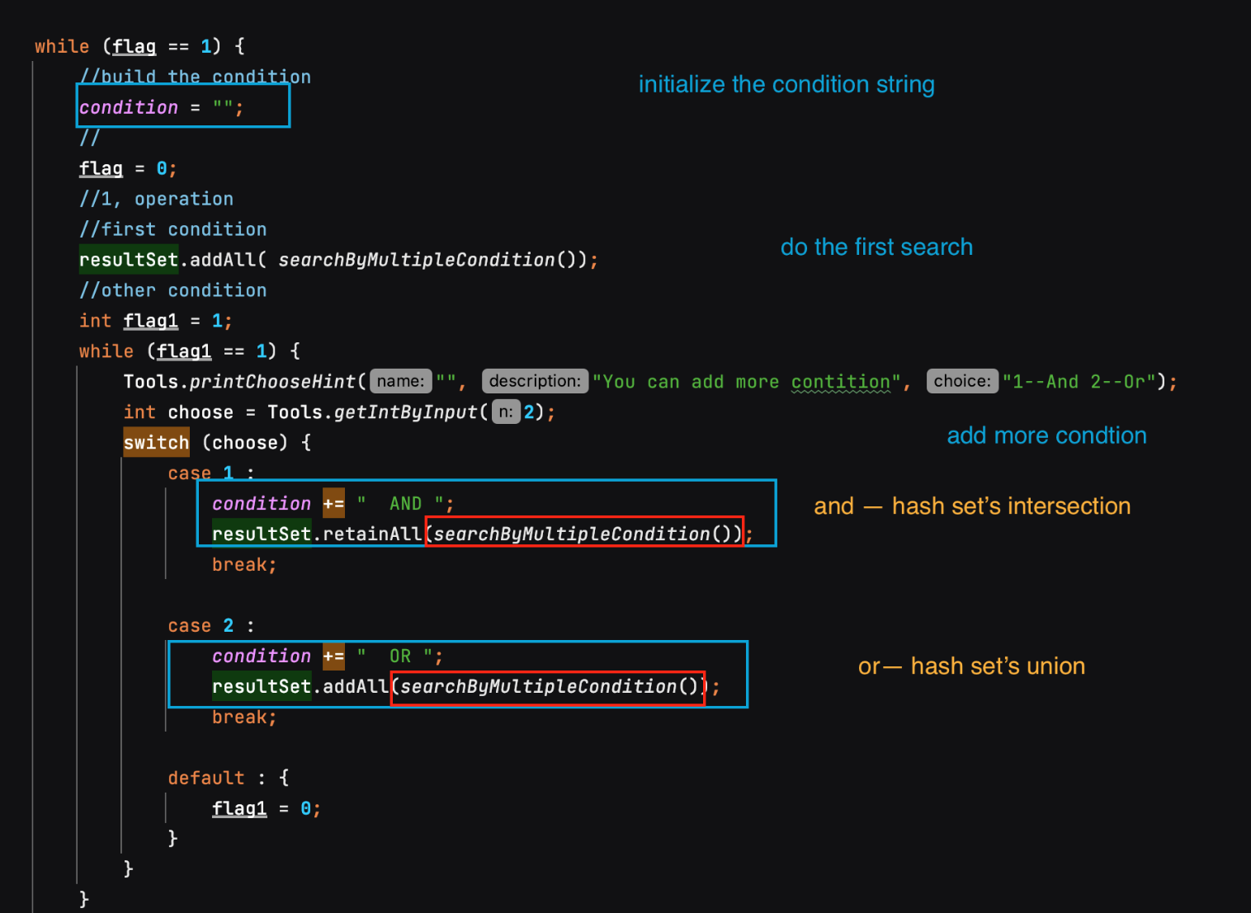
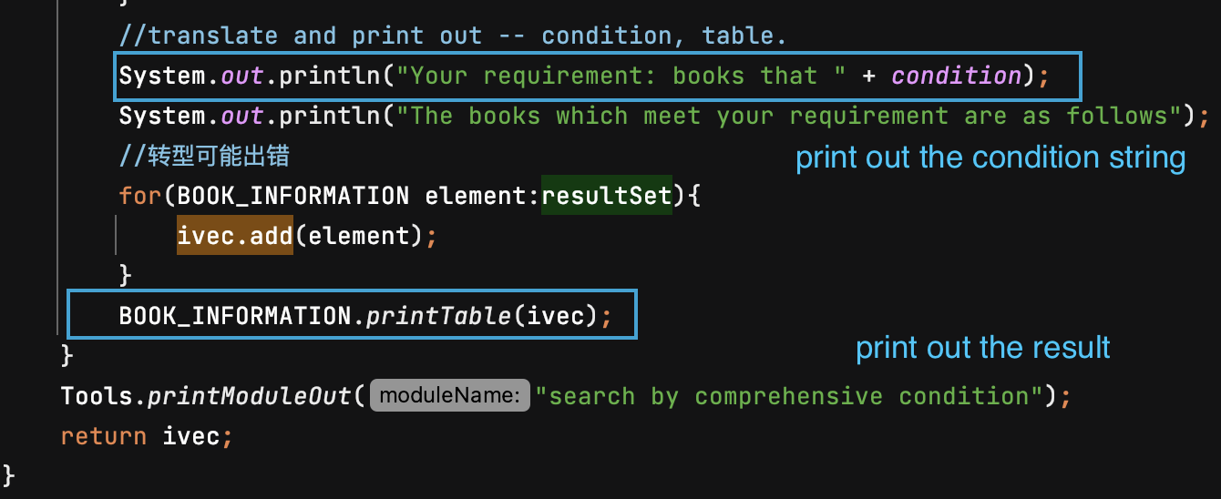
1, main part
.

Slide 31
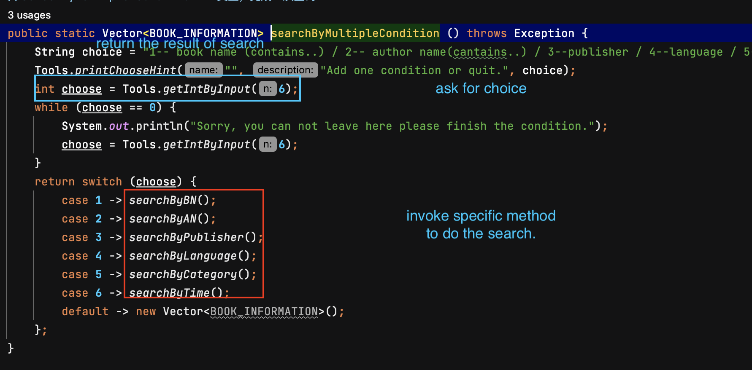
2, search by multiple conditions
.

Slide 32
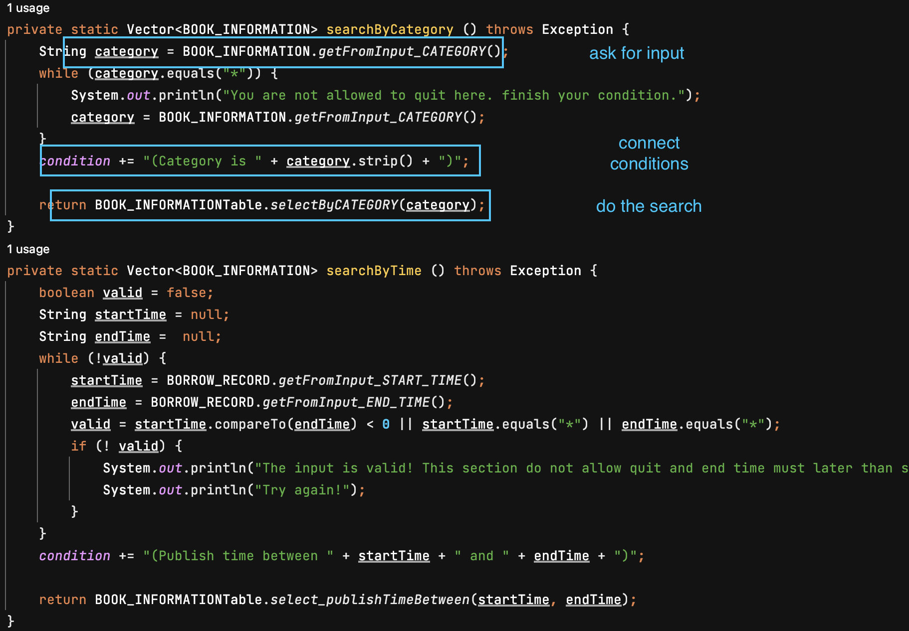
3, search by specific method.

Slide 33

4, analysis

Slide 34
1, encapsulation
adwantages
2, expandibility
3, security
1, efficiency can be improved
weakness
2, lack of concurrency control.

Slide 35

Thanks

